Slide 1

AGENT-BASED MODEL
From LOCAL RULES to EMERGENCE
Ruoqing ZHANG

Slide 2
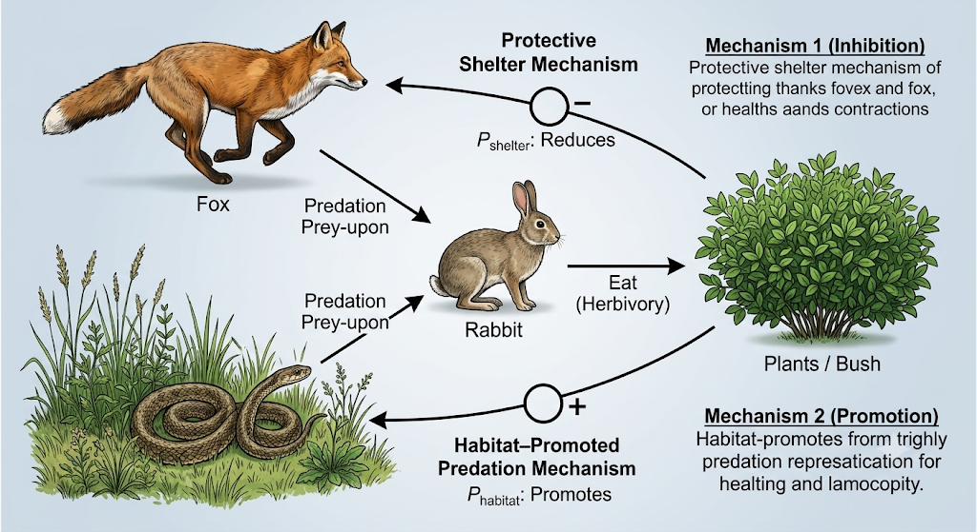
Fox-Rabbit-Snake-Plant

Slide 3
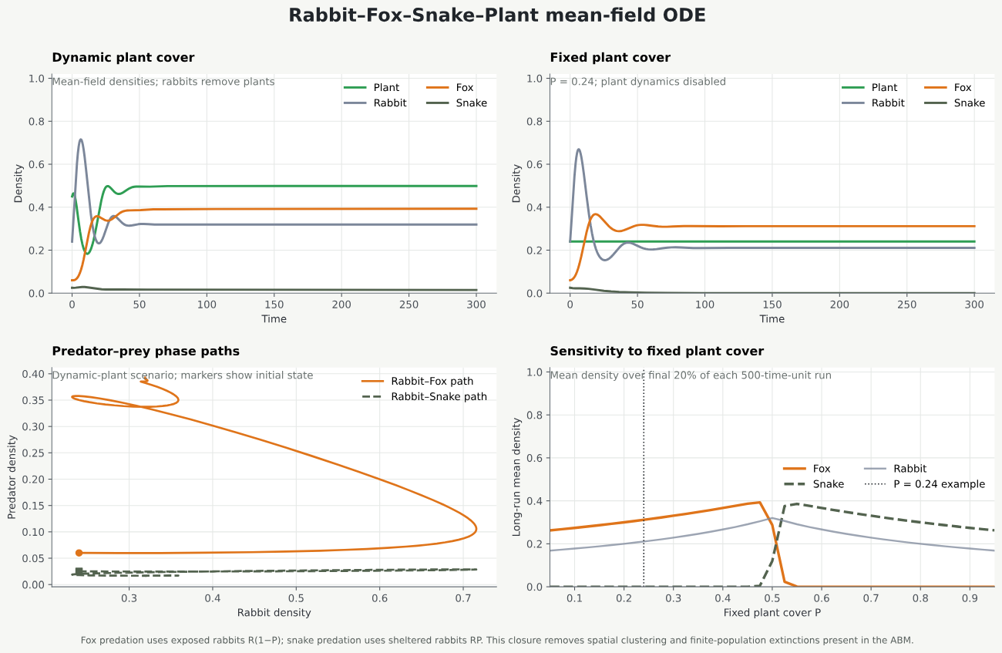
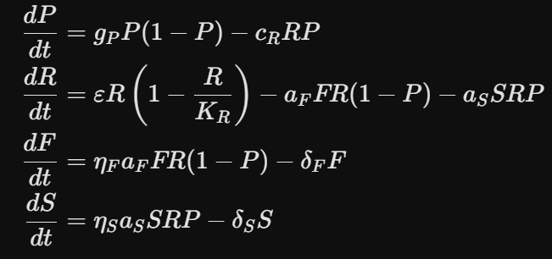
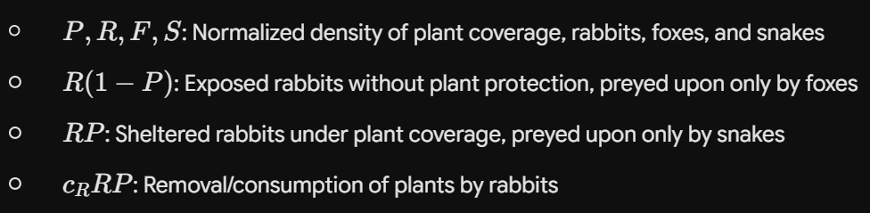
ODE model
But do we have other ways to build the model?

Slide 4

John Conway's Game of Life
Rules:
Alive cell: survives with 2 or 3 live neighbors.
Dead cell: becomes alive with exactly 3 live neighbors.
    Otherwise: the cell is dead in the next generation.

Slide 5

Cellular Automata
Each square is one cell. Black means 1/on; white means 0/off.
A new cell is calculated from the three cells above it: left, center, right.
Black result for 100, 011, 010, or 001. All other triples become white.
One starting cell grows into a pattern

Slide 6
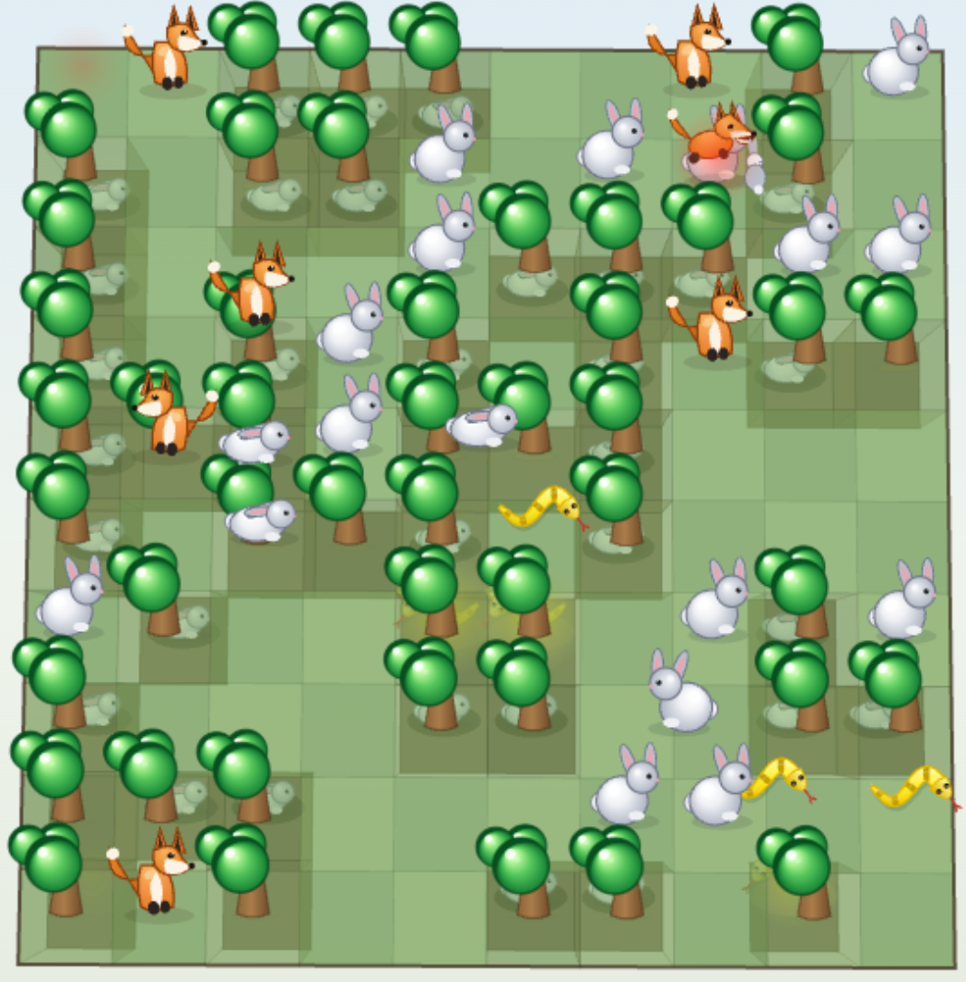
Agent Base Model
‘Instead of writing a single master equation for the entire population, we first describe how each individual behaves, interacts and evolves, and then allow population-level regularities to emerge spontaneously from massive individual interactions.’ (From ChatGPT 5.4)
https://kimsneppen.github.io/models/rabbit_fox_snake_plants_v29.html

Slide 7

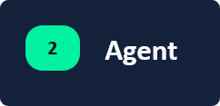

Structure of ABM
Foxes hunt rabbits in the wilderness and reproduce.
Fox
A 10 × 10 grid with randomly distributed growing plants
Rabbits feed on plants and reproduce.
Rabbit
Snakes prey on rabbits in woodlands and reproduce.
Snake

Slide 8
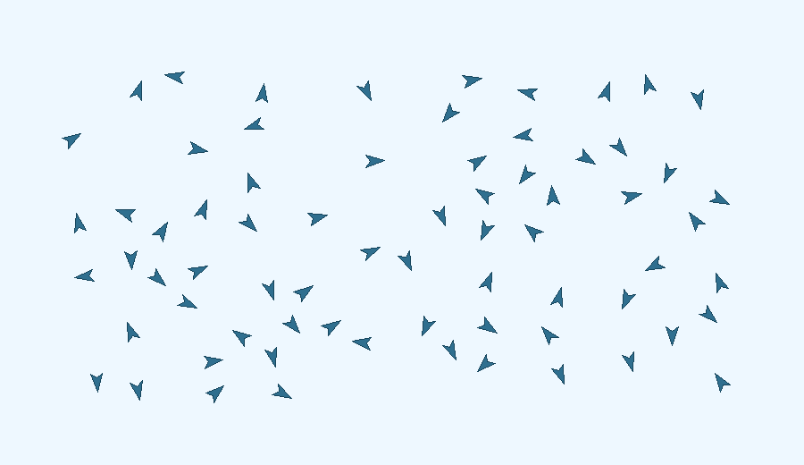
Emergence
Individual
Group
1. Avoid birds that are too close.
2. Fly toward the average direction of neighboring birds.
Birds fly in neat formations.neighboring birds.
3. Move closer to the centre of neighboring birds.

Slide 9

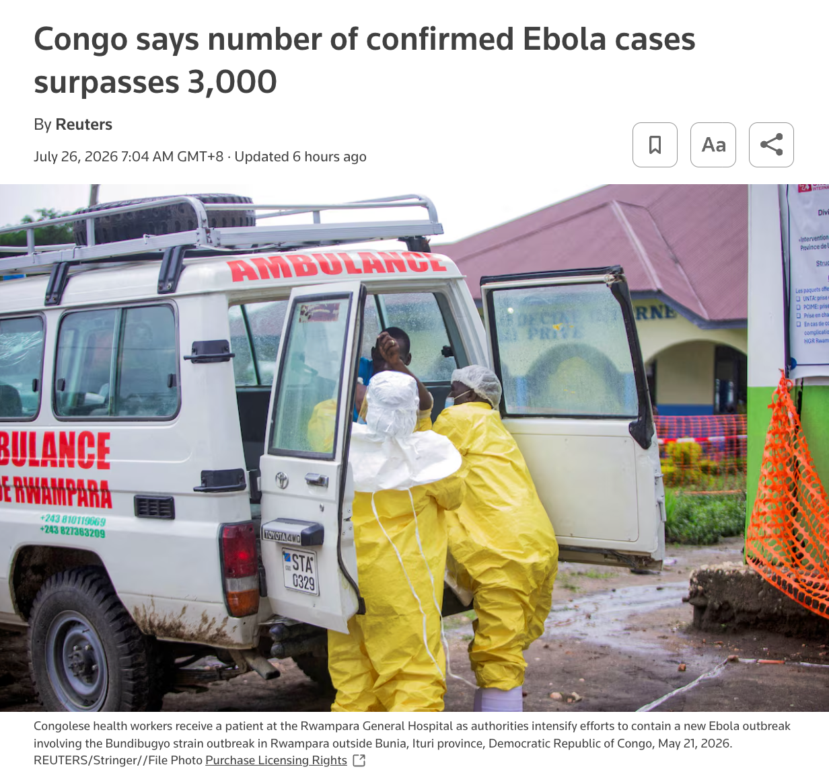
ABM in Epidemic

Slide 10
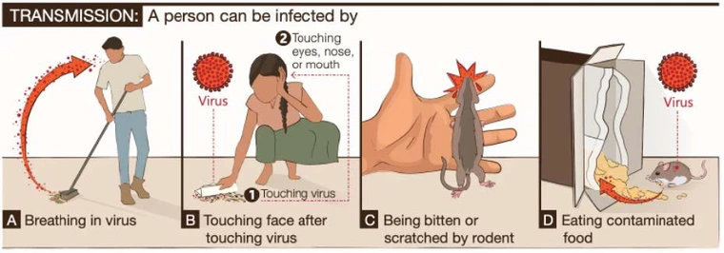
ABM in Hantavirus Spreading

Slide 11
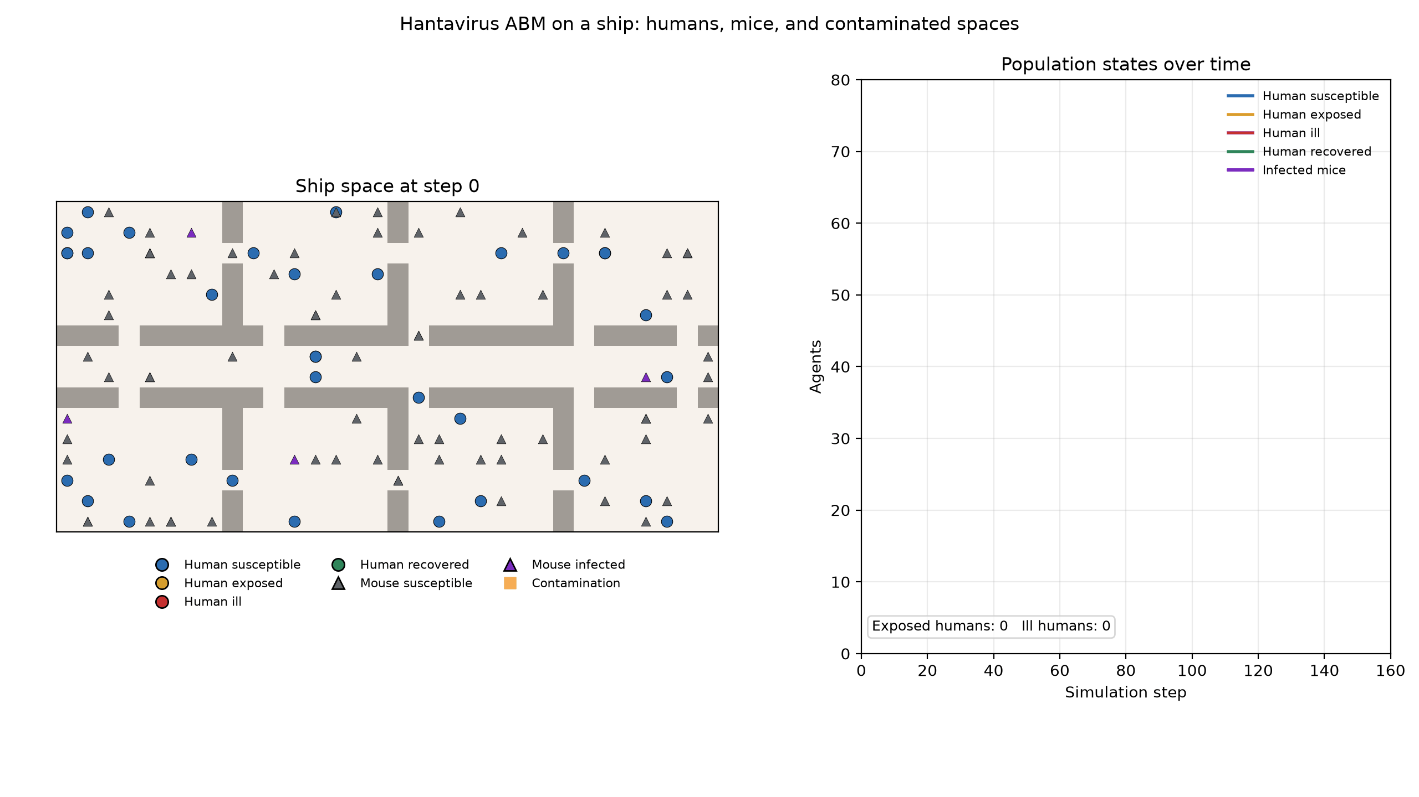
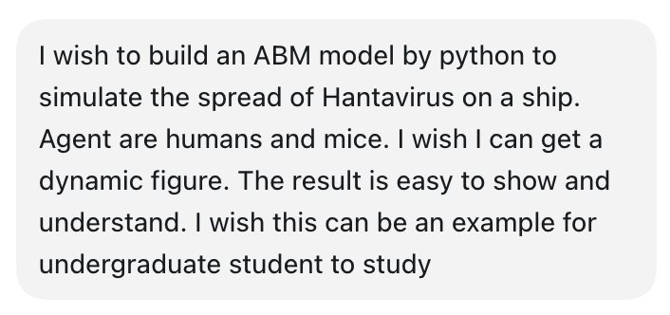
Round 1 (Build basic model by Agent)

Slide 12
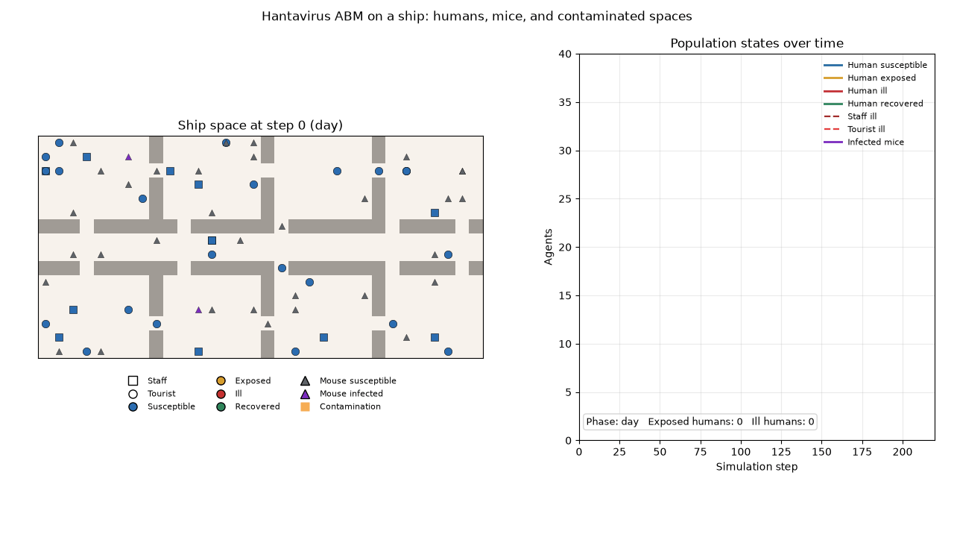
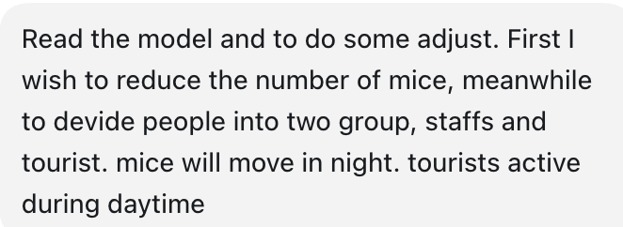
Round 2 (Adjust the rules)

Slide 13
Have a try!
Using AI to build an Agent-Based model for the problem you are interested in.
Cell self-organization
Honeybee colonies search for food sources
Microbial social interactions
Cells transfer in tissue
Species migration
Competition between species for limited resources

Slide 14
Reference and AI Disclosure
1.
Craig W. Reynolds. 1987. Flocks, herds and schools: A distributed behavioral model. SIGGRAPH Comput. Graph. 21, 4 (July 1987), 25–34. https://doi.org/10.1145/37402.37406
2.
Kim Sneppen, Rabbit–Fox–Snake–Plant ABM v29. https://kimsneppen.github.io/models/rabbit_fox_snake_plants_v29.html
3.
Palash Sarkar. 2000. A brief history of cellular automata. ACM Comput. Surv. 32, 1 (March 2000), 80–107. https://doi.org/10.1145/349194.349202
4.
Alfred Fournier et.al. Hantavirus and Disease Prevention. 2025. https://extension.arizona.edu/publication/hantavirus-and-disease-prevention
In this tutorial，ChatGPT5.5 and Codex were used to organize slide text, polish text, adjust powerpoint background, generate code and generate schematic. All content has been reviewed and revised by the presenter.

